Slide 1

EPWBA
Coaches’ Meeting
October 26th, 2024

Slide 2
agenda
EPWBA’s Mission
EPWBA Principal Core Values
Overview of League: About Us
The Pipeline
EPWBA League Structure
Special Rules Requirements
Coaching Suggestions
Questions & Answers

Slide 3
EPWBA’s Mission & Vision
Mission Statement: Our mission is to promote, develop, and teach all volunteers and participants GOOD CHARACTER, PHYSICAL HEALTH, SPORTSMANSHIP, TEAMWORK, DISCIPLINE and FAIR PLAY.

Slide 4
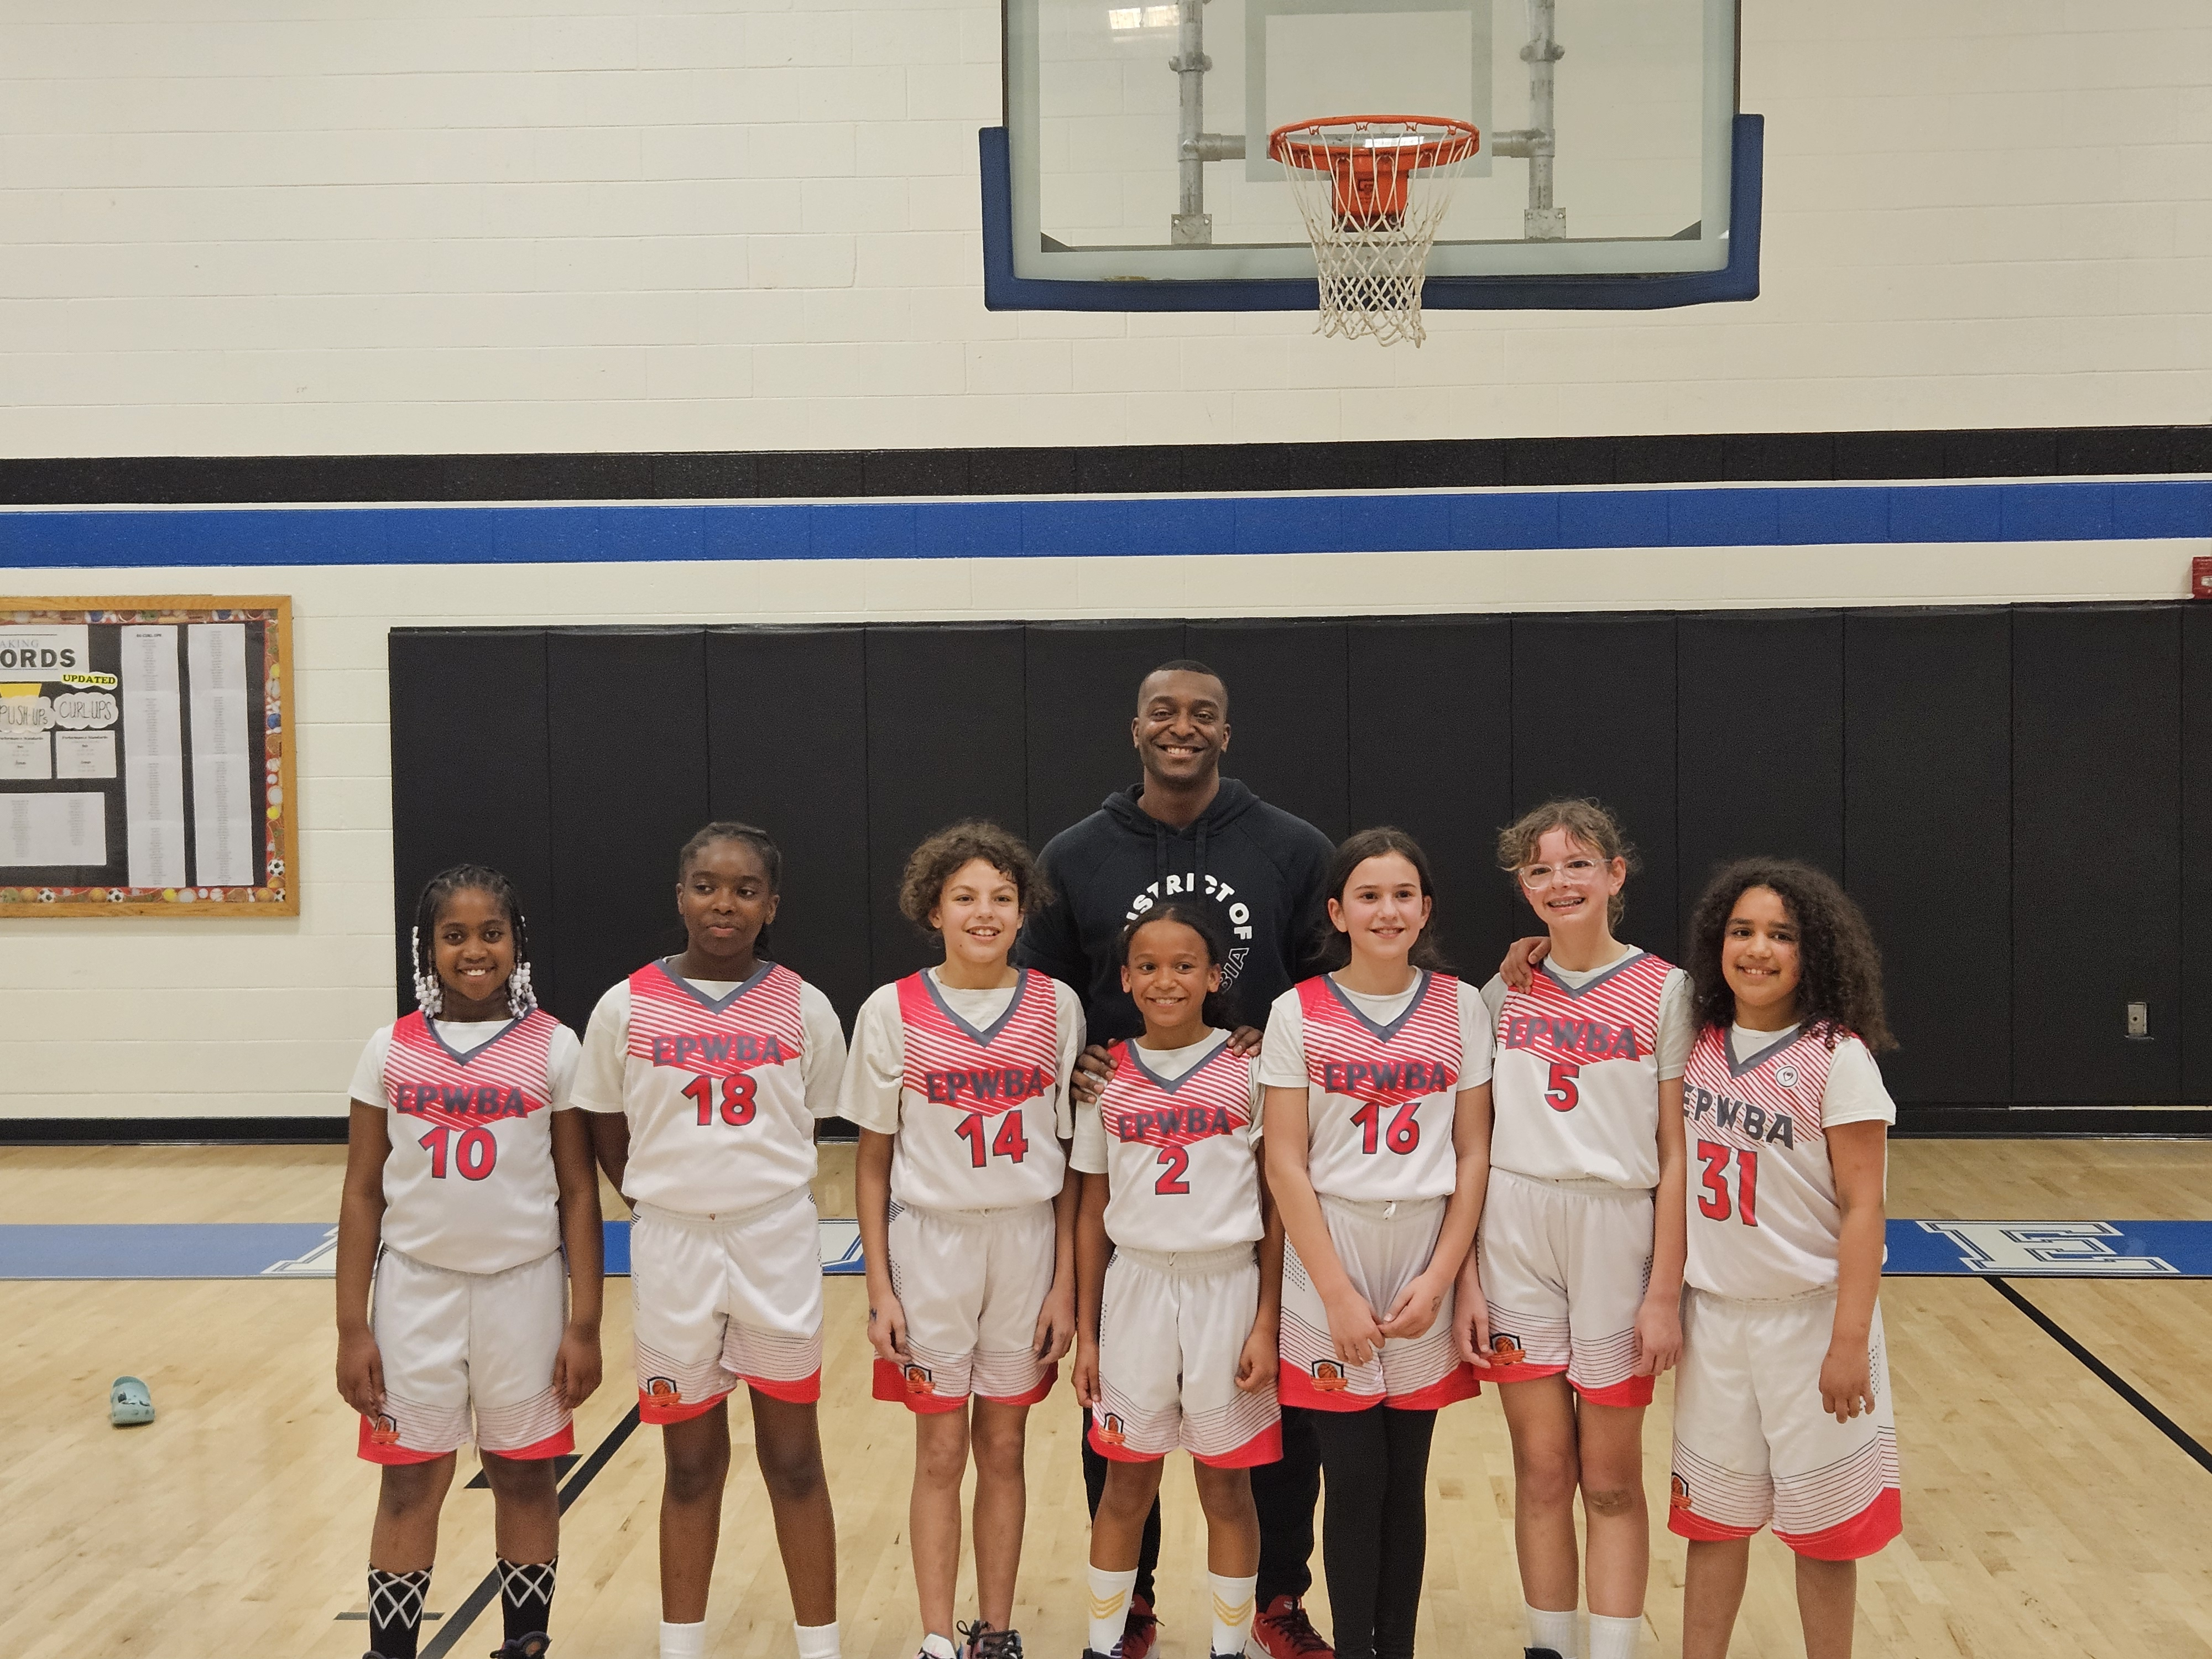
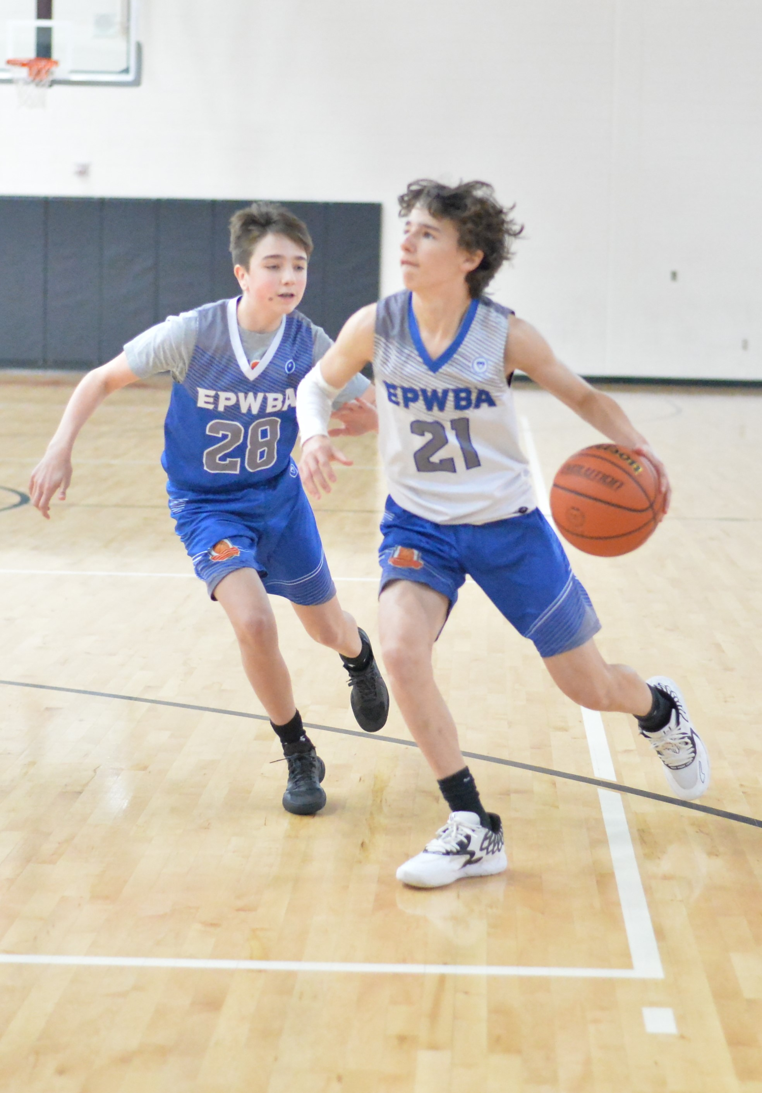
EPWBA Principal Core values
Good Character
Physical Health
Sportsmanship
Teamwork
Discipline
Fair Play

Slide 5
Overview of league:
About us
Non-profit 501(c)3 Recreational Basketball League established in 1971
All volunteer staff (League administrators and coaches)
Annually hosts recreational basketball league in Winter along with Summer clinics & training
  Coordinate facility usage of PWCS schools with the PWC Department of Parks, Recreation & Tourism
  In 2018 established a co-ed Instructional League
    2nd and 3rd grade first-time players (fundamentals, 3v3, MTM defense)
  2024-25 Introduction of the Novice League
    1st grade training platform; two 5-week sessions as an introductory program
    This is also an opportunity for local HS Varsity players to give back to the community by assisting with training new players

Slide 6
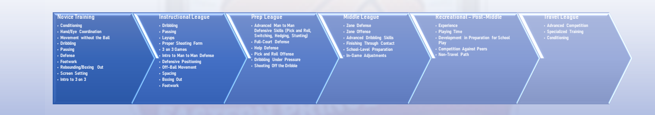
“The PIPELINE”
Introducing a developmental model for our players starting with our grassroots Novice/Instructional Leagues
The Pipeline outlines key skills and milestones players should achieve at each level
  Helps coaches hone the skills training to the appropriate level of the league they’re responsible for coaching

Slide 7
EPWBA LEAGUE structure
~650 to 850 participants annually (70+ teams)
Instructional League (2nd & 3rd Graders) – Co-Ed, 3 on 3 with lowered baskets
Prep League (4th & 5th graders) – separate boys and girls teams (MTM defense only)
Middle League Boys (6th & 7th graders)
Middle League Girls (6th - 8th graders)
New! Boys and Girls Middle League Travel Teams
Freshmen League Boys (8th & 9th graders)
High School League (10th – 12th) and recent HS graduates who haven’t started college; max age 19 yrs old

Slide 8
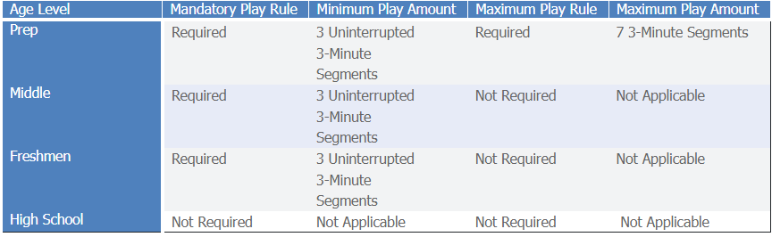
Special Rules Requirements
Mandatory Play Rules

Slide 9
Special Rules Requirements, cont’d
Pressing/Running Up the Score
    Teams with 15+ point lead will not be allowed to press or play full court defense.
    For Quarters 1-3, any time there is a 20+ point difference, the game clock runs continuously, except for mandatory substitutions or the game officials stop the clock (time out, injury, etc.)
    Any time the lead drops below 20 points difference, the clock reverts to a stop clock
    Once a 20-point lead is established in the 4th Quarter, the clock continues to run unless the game officials determine otherwise

Slide 10
Coaching Suggestions
Practice Planning
Line Up Planning to Meet Minimum Play Rules
Understand the Rules!
Truancy Clause – New!

Slide 11
Special Rules Requirements, cont’d
Uniform Wear
    Players are allowed allowed to wear shirts underneath their jerseys but it must adhere to the following mandate
      Home (White Side of Jersey) - White T-Shirt or Shirt with No Sleeves
      Away (Colored/Non-White Side of Jersey) - Black T-Shirt or Shirt with No Sleeves

Slide 12
League INFO/points of contact
Website: https://www.epwba.org
President/League Commissioner:
  Darrell Randolph, (571) 494-1821
  epwba.commissioner@gmail.com
League Administrator/Scheduler:
  Marcus Atkinson, (703) 957-8405
  meatkins09@gmail.com
Check out the “Coaches Corner” on the Website on the Right Side of the Menu

Slide 13
Questions/Comments/Concerns?

