Slide 1
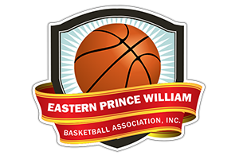
Skill Development Workouts

Slide 2
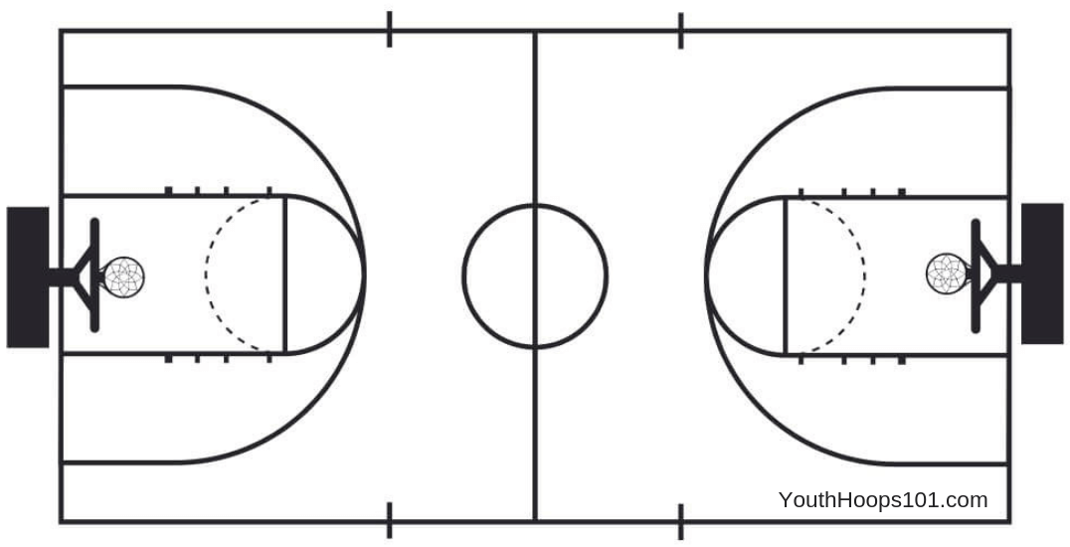
SHOOTING
DEFENSE
BALL HANDLING

Slide 3
Shooting Workouts

Slide 4
Setup
Players will occupy half the court (3 baskets)
Workout will be 10 minutes
3 minutes to review drills
3 minutes of form shooting
4 minutes of shooting drills

Slide 5
Form Shooting
Divide players between the three baskets
All players need a ball for this 3 minute drill
Standing 3-5 feet in front of the basket, have player practice one hand form shooting. If players are consistently making the shot, they can take 1 step back
Have players rotate positions after 1 minute so they shoot on the two sides and in front of the basket
Video shows how to do the drill at home without a basket. (One-Hand Shooting Drill with Allan Houston)
Focus on keeping elbow up, elbow in, and holding follow-through

Slide 6
Jump Stop Shooting Drill
Jump Stop Shooting Drill
On the main basket, divide into two teams
4 balls (2 per team) are needed.
Line each team up on either elbow.
Each player will take 2 dribbles, come to a jump stop, and shoot. Get their rebound and pass to the next teammate
First team to make 4 shots wins. If teams struggle to make baskets, limit rounds to 2 minutes.
Mix teams up based on skill.
Continue playing for 4 minutes.

Slide 7
Fun Game– Knockout
Knockout
If time allows, players can play a game of knockout (usually 4 minutes)
2 Balls required
Players line up at the foul-line. Players shoot until they make it or the person behind them scores first (knocking them out)
Game continues until there’s only one player left.

Slide 8
Defense Workouts

Slide 9
Setup
Players will occupy one side basket for defense drills
Workout will be 10 minutes
3 minutes to review drills
3 minutes of defensive slides
4 minutes of man-to-man defense

Slide 10
Defensive Slides
Players will line up in two lines across the court
Drill will last 3 minutes, no ball required
Coach will blow the whistle to start. Players slap the ground, and get into a defensive stance and yell DEFENSE
Coach blows the whistle again and points the direction to have players slide. Continue to blow whistle and have them change direction.
45 seconds with 15 seconds rest x 3
Focus on staying low and not bending at the waist, keep back straight.

Slide 11
Zig Zag Defensive Drill
Players will line up in two lines on the sideline. They will partner up defense/offense
Drill will last 4 minutes, one ball per pair
Offensive player will dribble in a zig zag pattern to mid-court
Defensive player will play defense working to turn the offensive player.
Create a lane with cones or lines on the court to limit how wide the zig zag pattern is.
If defensive player tries to steal the ball, have them do the drill with their hands behind their back
Defensive Drills for Youth Basketball | Zig Zag Practice by Tara VanDerveer

Slide 12
Fun Game – Monkey in the Middle
This game should NOT be played until after 4th of July. This is a fun game to let players master the skills they have been developing.
Drill will last 4 minutes, one ball per group of 3
Players will divide into groups of 3.
Player in the middle is on defense and is trying to get a deflection or steal
If defection or steal, offensive passer is now in the middle
Each round is 30 seconds or when the defender gets a deflection/steal first
The Monkey in the Middle Basketball Drill

Slide 13
Ball Handling Workouts

Slide 14
Setup
Players will occupy one side basket for ball handling drills
Workout will be 10 minutes
3 minutes to review drills
3 minutes of stationary ball handling
4 minutes of dribbling

Slide 15
Stationary Ball Handling
Players will line up in two lines across the court
Drill will last 3 minutes, all players need a ball
20 reps with each hand
2 sets of each drill
Select 5-6 drills based on skill level.
Drills are listed in increasing difficulty on next slide
Focus on controlling the ball, increasing the speed of the dribble, looking up (not down at the ball)

Slide 16
Stationary Ball Handling Drills
Beginner:
Knee Speed Dribble
Below Knee Speed Dribble
Crossover
Around the waist passing (10 each way)
Figuring 8 passing (10 each way)
Intermediate
Side to Side (same hand)
Front to Back
Catch Drill (Basketball Dribbling Drills: Figure-eight & Catch Drill)
Experienced
Behind the back
Between the legs (left and right leg forward)
Spider Drill (Basketball Dribbling Drills : The Spider Drill in Basketball)
VIDEOS OF BALL HANDLING DRILLS
Ball Handling Workout
Basketball Dribbling Drills: Figure-eight & Catch Drill
Basketball Dribbling Drills : The Spider Drill in Basketball
Examples of other drills to be used
The 10 Minute Ball Handling Workout

Slide 17
Dribbling Drills
Players will line up in two lines on the sideline
Drill will last 4 minutes, all players need a ball
Run through 4 different skills
Focus on left and right hand
Players will dribble to mid-court and back while doing the same move multiple times (Cone Dribbling Drill)
Skills to focus on: hesitation, cross over, behind the back, between the legs

Slide 18
Fun Game – Construction Site
Best Basketball Drills for 6 Year Olds | Fun Beginner Basketball Drills by MOJO
This game should NOT be played until after 4th of July. This is a fun game to let players master the skills they have been developing.
Requires cones and every player having a basketball
Split into two teams.
Builders (Stand up cones)
Bulldozers (Knock down cones)
Goal – Knock down/Stand up as many cones as possible, while dribbling and stay moving
1 minute rounds.
After 1 minute, count number of cones standing/knocked down to determine winner.

